Slide 1


Choking
&
Other Concerns
June 2018
Lori Gephart
Rick Scott Governor
Barbara Palmer
APD Director

Slide 2
Agency for Persons with Disabilities
Program & Policy Manager
Bureau of Quality Management
Division of Clinical Supports
  Medical Case Managers (nurses)
  Behavior Analysts (CBAs)
  QSI

Slide 3


Slide 4
The agency serves more than 50,000 Floridians with the following disabilities:
People severely impaired by Autism
Cerebral palsy
Spina bifida
Intellectual disabilities
Down syndrome
Prader-Willi syndrome
Phelan-McDermid syndrome
Children age 3-5 who are at a high risk of a developmental disability

Slide 5
AGES
Waiver numbers (as of April 2018)
Age 60+ = 3,063
Age 23-59 = 25,269
Age 15-22 = 4,595
Age 6-14 = 1,326
Age 03-05 = 60

Slide 6

RESIDENCE
Waiver (as of April 2018)
Family Home = 19,606
Small Group Home = 7,098
Supported Living = 4,349
Large Group Home = 1,623
Independent Living = 1,015
Foster Homes = 372
Residential School = 122
Other = 128

Slide 7
CHOKING

Slide 8
What do we know?
TRUTH IS…
ANYONE CAN CHOKE…
anyone CAN CHOKE ON ANYTHING…

Slide 9
INDIVIDUALS WITH DEVELOPMENTAL DISABILITIES ARE AT A GREATER RISK
CONTRIBUTING FACTOR OF DEATH IN INDIVIDUALS OVER AGE 65
ALL SETTINGS
OVER 100,000 ER VISITS YEARLY
ALL AGES
CONTRIBUTING FACTOR OF DEATH IN CHILDREN

Slide 10
What you need to know…
CHOKING
blocking of the airway by liquids, food, or objects
partial or complete
DYSPHAGIA
difficulty swallowing
Derived from the Latin & Greek words meaning difficulty eating

Slide 11
What you need to know…
ASPIRATION
inhaling or breathing of foods, liquids, saliva, or objects into the trachea or lungs
“down the wrong pipe”
can happen while choking
can be “silent” – no outward signs

Slide 12
THE BASICS OF SWALLOWING
ORAL
PHARYNGEAL
ESOPHAGEAL

Slide 13
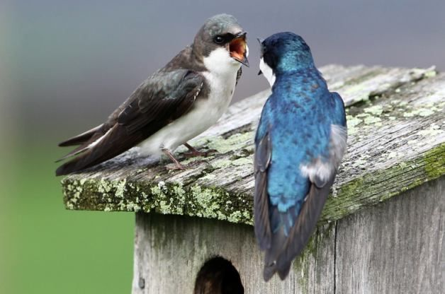

Slide 14
very
so
simple
No, not really
complex action
very
A

Slide 15
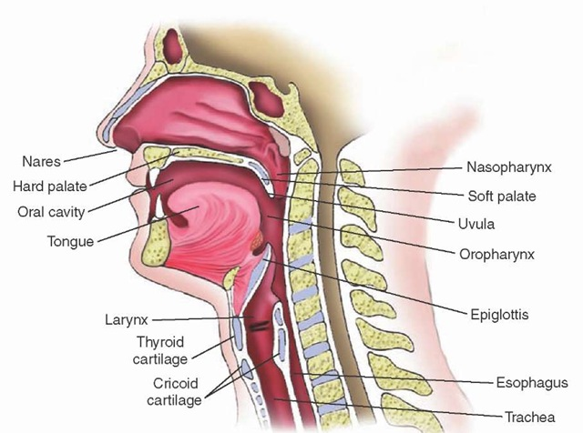

Slide 16
Mechanisms of swallowing
Tongue propels food into the pharynx (throat)
Soft palate elevates, upper pharynx contracts, pushing the food into the lower pharynx & at same time the larynx pulls upward so the epiglottis bends down
This closes off the opening to the larynx & trachea (windpipe) so food doesn’t enter the trachea
Pharynx continues to contract (wave) pushing the food along
Upper esophageal sphincter (ring of muscle that encircles the upper end of the esophagus) relaxes, allowing the wave to push the food (bolus) from the lower pharynx into the esophagus
The wave of contraction (peristaltic wave) progresses from the pharynx down the length of the esophagus

Slide 17
Mechanisms of swallowing
Bolus enters the upper esophagus where the lower esophageal sphincter (ring of muscle that encircles the lower end of the esophagus where it meets the stomach) relaxes so the bolus can pass into the stomach
After the bolus passes, the lower sphincter tightens to prevent the contents of the stomach from regurgitating back up into the esophagus. It remains tight until the next bolus comes along
Involves automatic reflexes, nerves, muscles, organs & the brain
Complexity explains why so much can go wrong

Slide 18
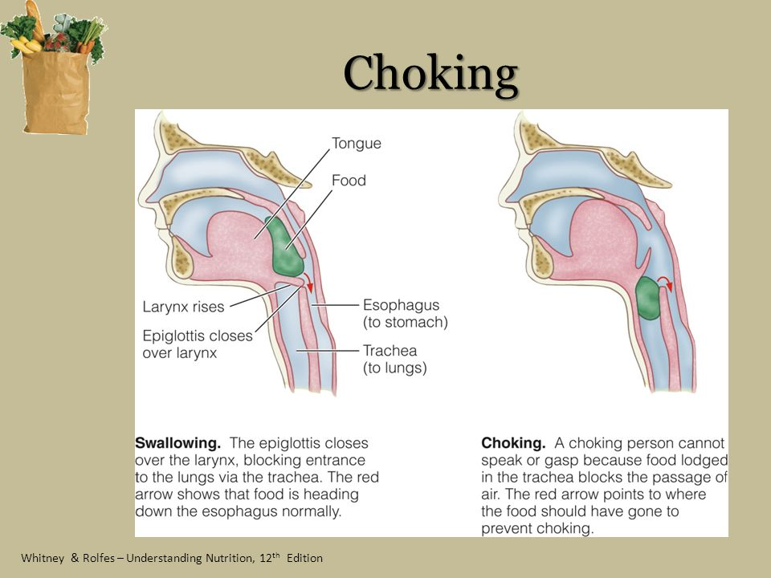

Slide 19
The universal sign for choking is hands clutched to the throat.
Other signs:
Inability to talk
Difficulty breathing or noisy breathing, wheezing, gasping for air
Squeaky sounds when trying to breathe
Cough, which may either be weak or forceful
Gagging
Skin, lips, and nails turning blue or dusky
Skin that is flushed, then turns pale or bluish in color
Waving arms
Loss of consciousness
If the individual is able to cough forcefully, they should keep coughing. If the individual is choking and can't talk, immediate action is required.

Slide 20
Factors that increase risk for choking/aspirating include:
■ Decreased or absent protective airway reflexes
■ Poor or underdeveloped oral motor skills or decreased muscle tone causing difficulty with chewing or swallowing
■ Difficulty holding head upright or sitting up straight
■ Gastroesophageal reflux disorder (GERD), cerebral palsy
■ Seizures

Slide 21
■ Dental issues, poor oral hygiene
■ Poor self eating skills
■ Food stuffing or rapid eating
■ PICA
■ Sedation for an exam or procedure
■ Medications that decrease or relax voluntary muscles
■ Impaired mobility, leaving individuals unable to properly position themselves for adequate swallowing
■ Requires mealtime support from someone who is not properly trained

Slide 22
■ Eating while standing, running, walking, or lying down
■ Eating in a moving vehicle
■ Serving foods like hot dogs, popcorn, bagels, peanut butter…
■ Failing to follow prescribed diets and textures
■ Inability to swallow certain fluid consistencies and/or food textures
■ Lack of supervision
■ Staffing
■ Chaotic meal times

Slide 23
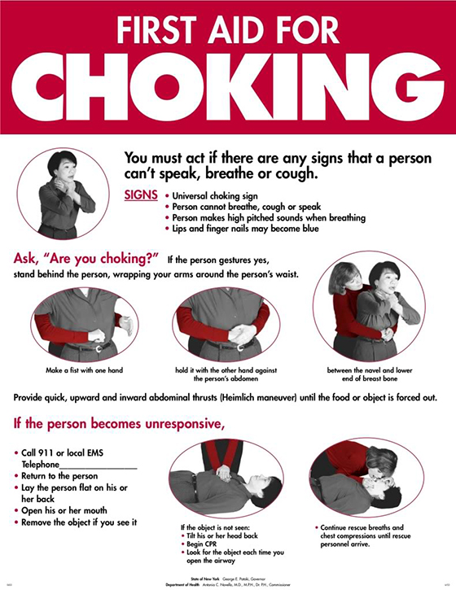

Slide 24
First Aid - Heimlich Maneuver on an Adult

Slide 25

If the person is sitting or standing, stand behind him or her. Form a fist with one hand and place your fist, thumb side in, just below the person's rib cage in the front. Grab your fist with your other hand. Keeping your arms off the person's rib cage, give four quick inward and upward thrusts. You may have to repeat this several times until the obstructing object is coughed out.

Slide 26
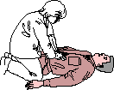
If the person is lying down or unconscious, straddle him or her and place the heel of your hand just above the waistline. Place your other hand on top of this hand. Keeping your elbows straight, give four quick upward thrusts. You may have to repeat this procedure several times until the obstructing object is coughed out.

Slide 27
Perform the Heimlich Maneuver on a Person in a Wheelchair
Ask, "Are you choking?"
Remain calm.
Look for signs that the person is suffering from total airway obstruction. These signs include the victim being unable to make any sounds above a wheeze, the face turning blue, and hands clutching the throat in the universal symbol for choking.
Engage the wheelchair's brake if it's not already on.
Stand or kneel behind the victim's wheelchair. If the back of the wheelchair is too high, turn the person 90 degrees or support in a standing position.
Lean the victim forward, moving the head and torso down at a slight tilt.

Slide 28
Make a fist with one hand.
Place your fist about a finger's width above the victim's navel with your thumb in contact with his body. Make a fist with one hand.
Place your fist about a finger's width above the victim's navel with your thumb in contact with his body.
Grab hold of your fist firmly with your other hand.
Make a quick in-and-up thrust against the victim's diaphragm. You may need to repeat thrusting several times before the object is expelled.
Repeat until the choking person can breathe, the object is expelled, or the victim loses consciousness.
Call 911 for medical help.

Slide 29
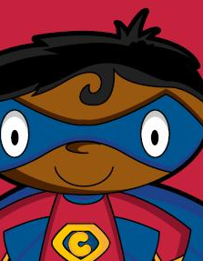
CAPTAIN
PREVENTION

Slide 30
WHAT CAN YOU DO?
KNOW WHAT YOU CAN DO… do you know what to do…

Slide 31


Slide 32

the
PLAN
is to have a
PLAN
before you need a
PLAN

Slide 33
Training
Everyone needs to be trained

Slide 34
position
Keep CPR & First Aid certification up to date
training
observation
supervision

Slide 35


Slide 36
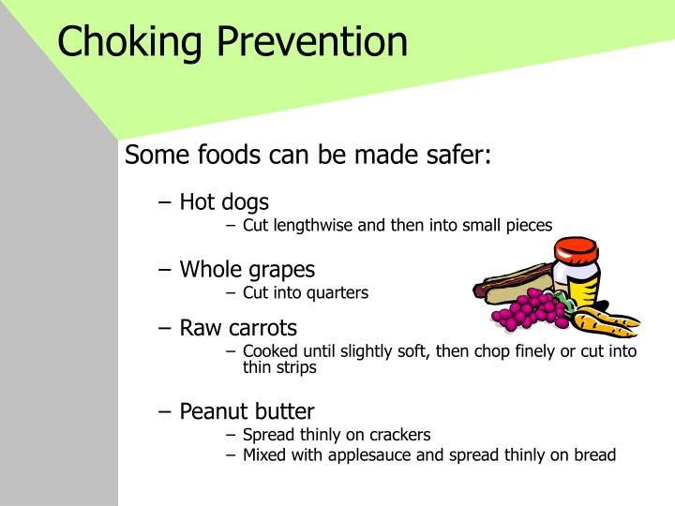

Slide 37
Some foods such as hot dogs, sausage, bread, bagels, popcorn, and peanut butter are difficult to swallow and can increase the likelihood of a choking incident, regardless of whether the individual has been identified to be at risk.
Other foods due to their shape, size, or the tendency to eat in one bite (nuts, grapes, large marshmallows, hard candy, apples, carrots, chips) can increase the likelihood of choking.

Slide 38
Even individuals with no identified risk or special needs can benefit from reminders to eat slowly, chew, and take one bite at a time.
Non-food objects such as coins, beads, marbles, pen/marker caps, small toy parts, small batteries, and balloons may lodge in airway and pose a risk especially for individuals who have pica or mouthing behaviors.

Slide 39
PREVENTION IS CRITICAL!
Mealtime can be good for some, while difficult for others.
Supervision and observation is crucial for choking prevention.
Providers need to be trained in food textures and liquid consistencies.
Identify problems early, develop interventions & follow the protocols to ensure the health & safety.
Many choking incidents are preventable.

Slide 40
Choking Prevention – a Priority for APD
May 18, 2017
The Clinical Supports unit at APD’s State Office reviews all client deaths. A trend was discovered: choking on food as a contributing factor to the deaths increased dramatically over a relatively brief period.
To address this, Registered Nurses in the Clinical Supports unit, with the generous financial support and assistance of the Arc of Florida, created a cutting board that illustrates how to properly prepare food to prevent choking. The cutting boards visually show the most commonly ordered diet textures – pureed, ground, and cut to size – with true-to-size representations of ¼”, ½”, and 1” pieces of food.
The APD Medical Case Managers (RNs) statewide delivered the cutting boards to group homes and adult day training programs, along with technical assistance on strategies to prevent choking, choking risks and causes, and reminders on what to do when someone chokes.

Slide 41
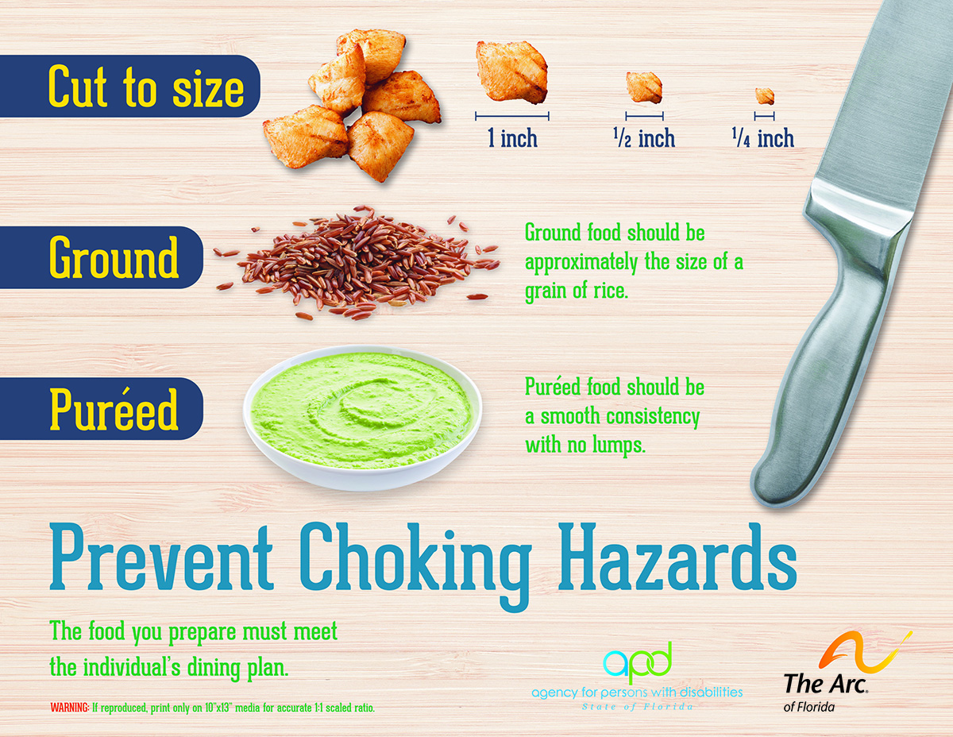

Slide 42
OTHER CONCERNS associated with preventable deaths
Aspiration
Constipation
Dehydration
Seizure Disorder

Slide 43
ASPIRATION
inhaling or breathing of foods, liquids, saliva, or objects into the trachea or lungs

Slide 44
Common cause of death in group care settings
Subtle, silent while compromising the respiratory status
Aspiration pneumonia not always detected right away

Slide 45
CONSTIPATION
Constipation is having fewer than three bowel movements a week.
Constipation is a symptom, not a disease.
Bowel movements are usually hard, dry, and cause straining & pain when passing stool.
A side effect of many medications is constipation.
Constipation is one of the most common GI problems.
Complications of constipation can be serious.
Constipation doesn’t feel good.

Slide 46
COMPLICATIONS
FISSURES
HEMORRHOIDS
IMPACTION/ obstruction
PROLAPSE

Slide 47
PREVENTION
Balanced diet
Fluids
PREVENTION
Activity
Positioning
PREVENTION
Fiber
Limit caffeine

Slide 48
DEHYDRATION
Occurs when the body loses more fluid than it replaces.
The body is affected by dehydration and it will cause significant health problems (constipation, altered mental status, shock, urinary issues, increase in seizure activity, coma, death).
Individuals who are unable to access fluids without assistance are at greater risk.
Dysphagia (difficulty swallowing).
Not all fluids are good fluids.
Restricting fluids to prevent incontinence has consequences.

Slide 49
PREVENTION
Diet
Fluids
PREVENTION
Activity
Reminders
PREVENTION
Signs/Symptoms
Monitor

Slide 50
SEIZURES
Higher incidence
Increased incidence of sudden death (SUDEP)
Medications
Drug toxicity
Types
Managing a seizure
  Signs of an emergency

Slide 51
MANAGEMENT
Diet
Fluids
MANAGEMENT
Activity
Medications
MANAGEMENT
Devices
Monitoring

Slide 52


Slide 53






QUESTIONS?

Slide 54


Slide 55

Thank you

Slide 56


